Slide 1

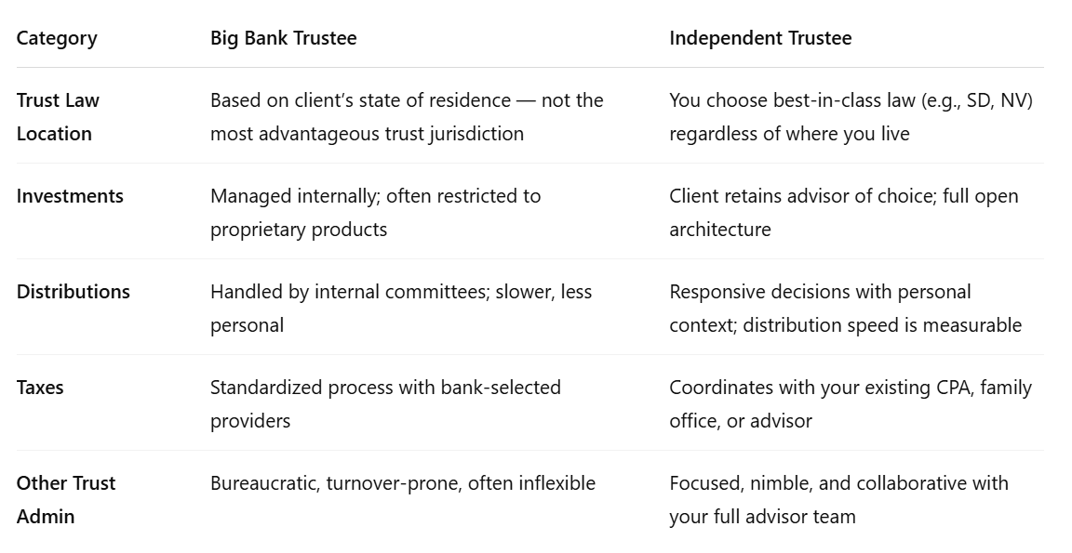
Big Bank Trustees and Independent Trustees
© Copyright 2025 Wealth Advisors Trust Company. All Rights Reserved.
1

