Slide 1

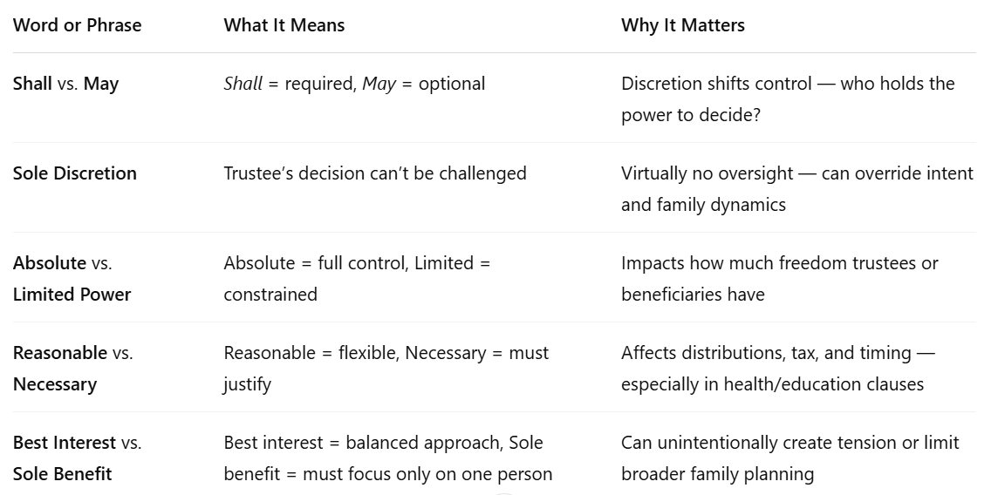
Power Words in Trusts
© Copyright 2025 Wealth Advisors Trust Company. All Rights Reserved.
1

