Slide 1

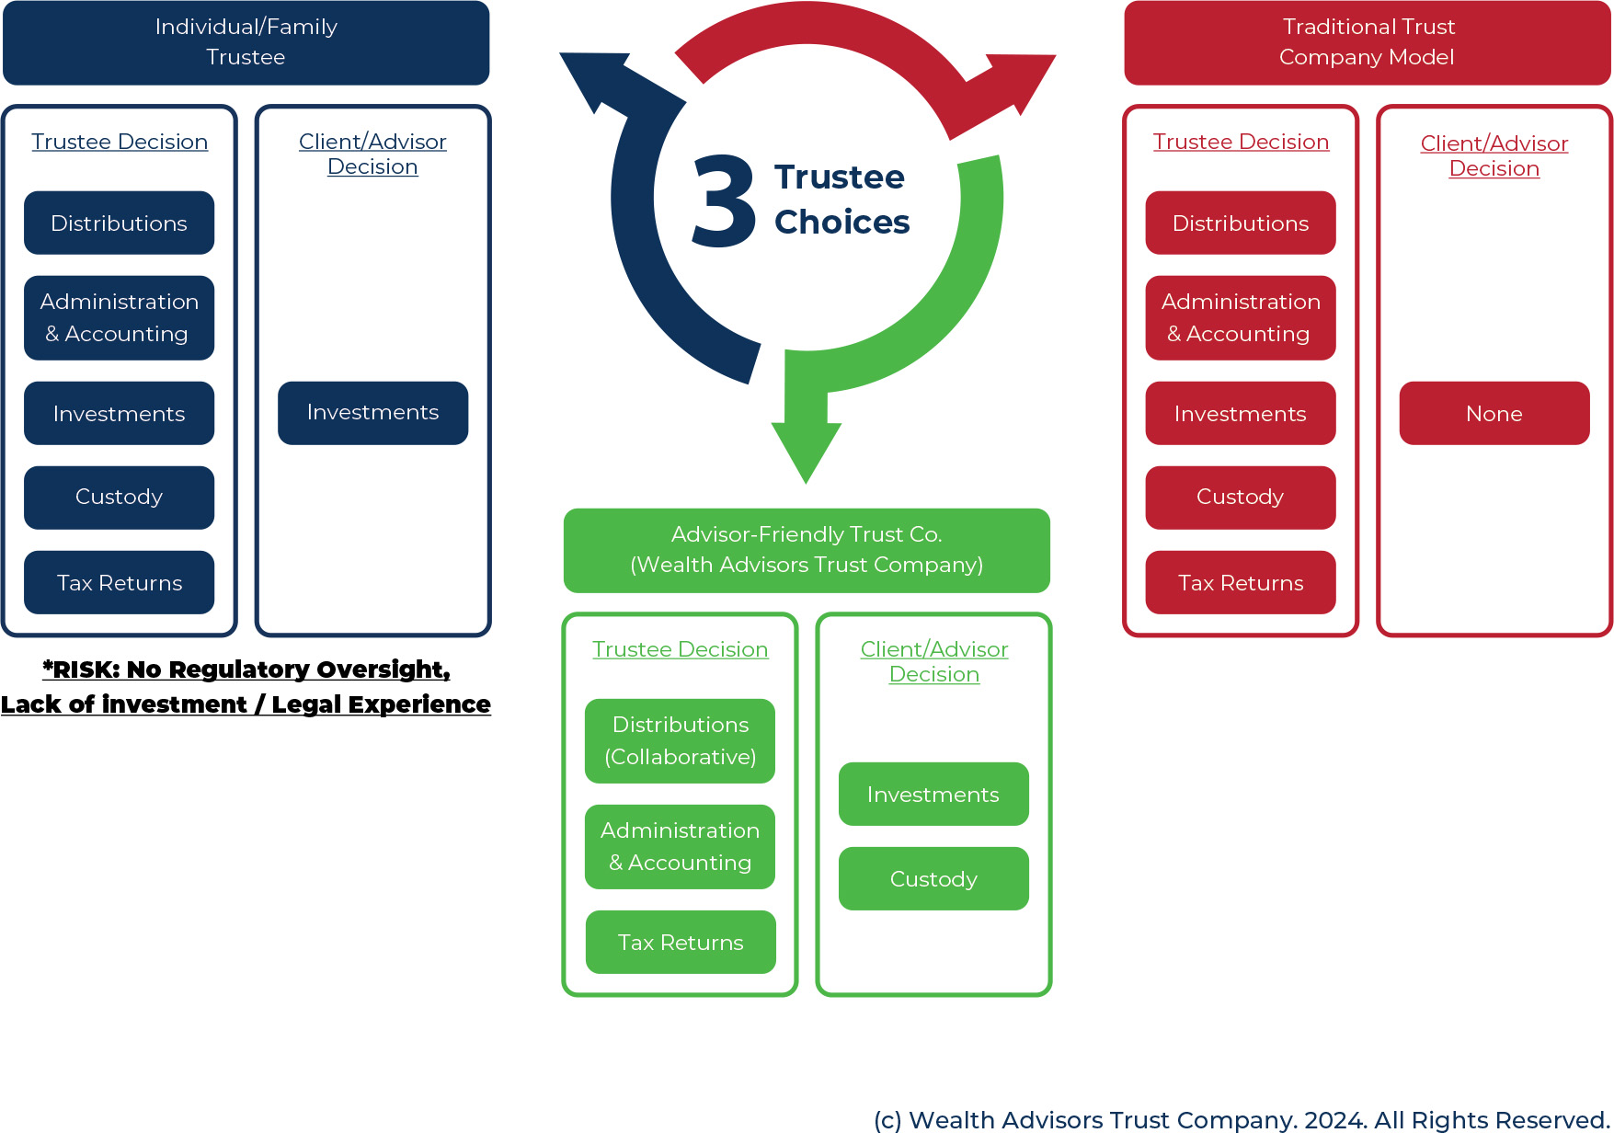
© Copyright 2024 Wealth Advisors Trust Company. All Rights Reserved.
1

